Slide 1
“ Artificial Intelligence and Cybersecurity
in Civil and Military Aviation”
Challenges to Civil Aviation
The view of Italian CAA
Ing. Sebastiano Veccia
Director, Security Directorate
Larnaca – Cyprus 30 May 2024

Slide 2
What is AI

Slide 3
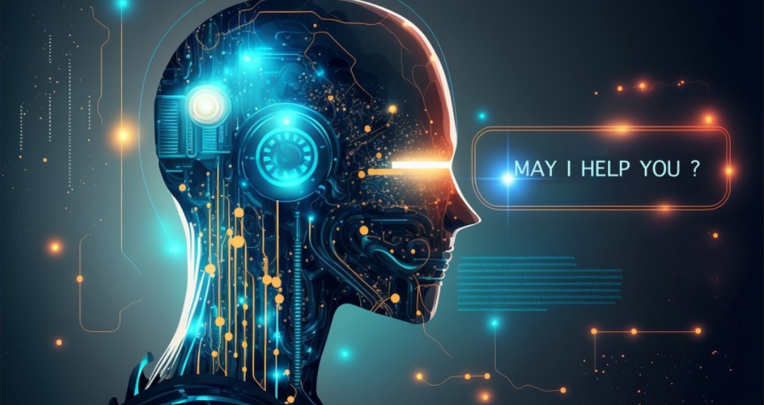
Introduction

Slide 4
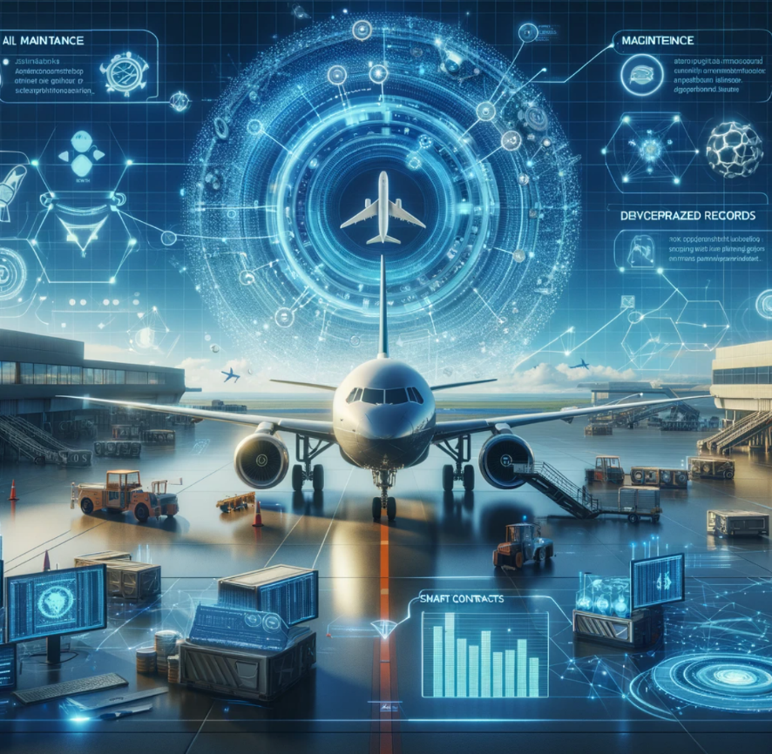
Benefits of AI in Civil Aviation
Enhanced Safety and Security
Automation of Routine Tasks
Personalisation of Customer Experience
Improve Operational Efficiency

Slide 5
The Main 7 Challenges
Reliability and Decision-making
Integration with Existing Systems
Regulatory and Legal Challenges
Ethical Aspect
Privacy Ensurance
Workforce Implications
Information Security Aspects

Slide 6
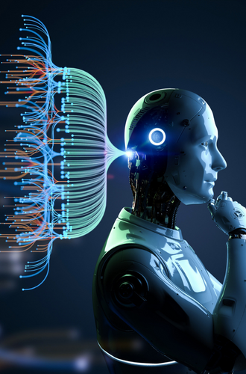
Challenges
Reliability and decision-making
Availability and Accuracy
Validating Performance
Interpreting Decisions

Slide 7
Challenges
Integration with existing systems
Compatibility and Investments
Continuity and Coordination
Reliability and Safety Standards

Slide 8
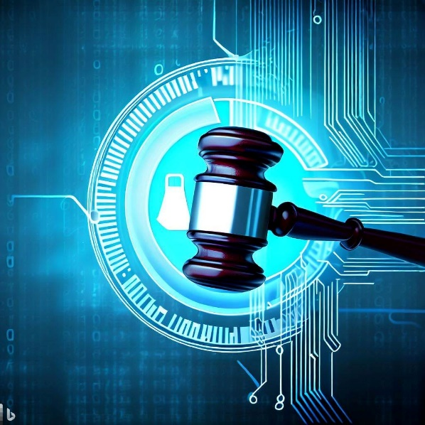
Challenges
Regulatory and Legal
a. Establishing Standards and Certifications
There is currently a lack of specific regulatory standards for the use of AI in aviation.
b. Liability and Accountability
Determining liability in the event of a failure involving AI poses a legal challenge.

Slide 9
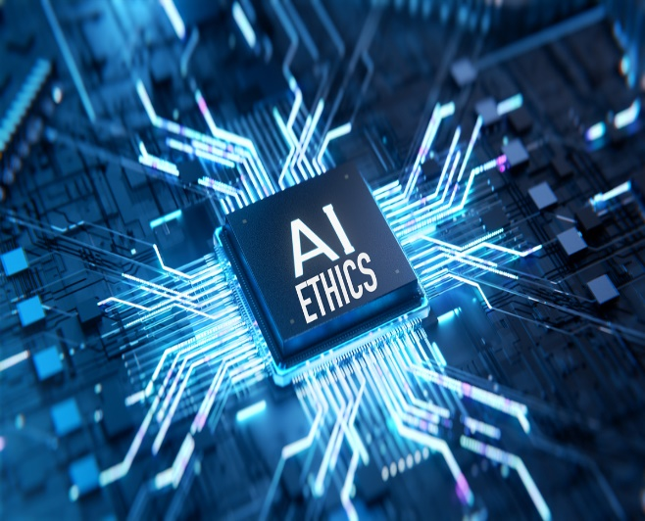
Challenges
Ethical aspect
Algorithmic Bias
Complexity of Algorithms
Oversight and Intervention Capabilities

Slide 10
Challenges
Privacy ensurance
Transparency of Decision
Protecting Sensitive Info
Data Protection and Privacy

Slide 11
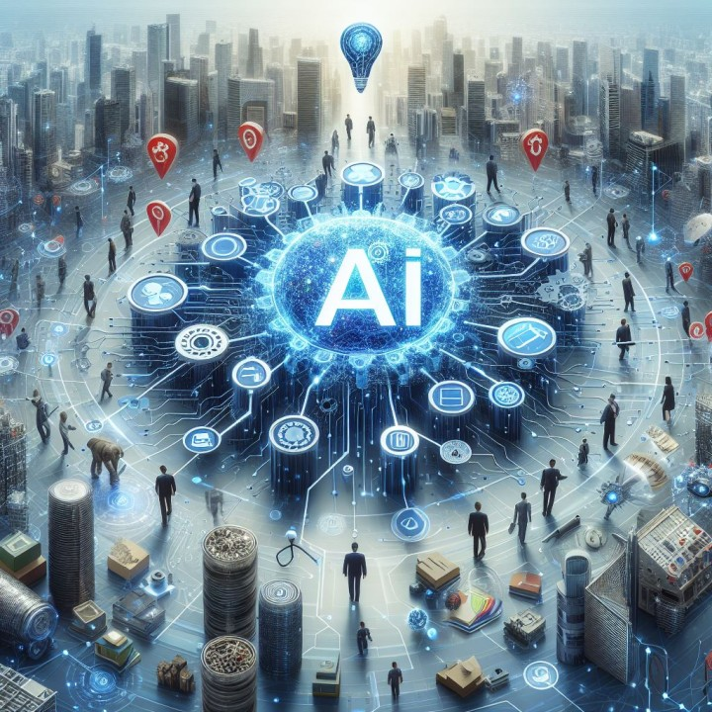
Challenges
Workforce implications
Job Displacement/Changes
Avoid Skill Degradation
Training on AI Systems
Oversight and Continuous Monitoring

Slide 12
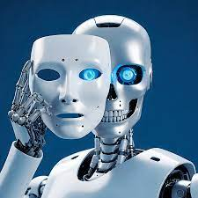
Challenges
Information Security aspects
Defend Cyber Attacks
Avoid System Failure

Slide 13
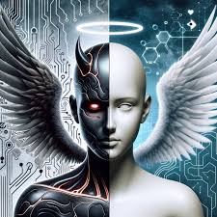
Conclusions
PRO |  | CONS
enhancing safety improving operational efficiency personalizing the customer experience. |  | cybersecurity risks job displacement ethical concerns

Slide 14
Thank you for your attention
s.veccia@enac.gov.it

